Slide 1


Stochastic Signal Analysis Project
Group name (if any) and members
Glasgow College
University of Electronic Science and Technology of China
20XX/XX/XX
Notes:
高性能低功耗压控振荡器

Slide 2


1
Background and Problem Statement
2
Dataset
Contents
3
Project Tasks and Evaluation Metrics
4
Proposed Methods
5
Evaluation and Results
5
Conclusion

Slide 3

Chapter 1
Background and Problem Statement
Briefly introduce tropical-depression analysis and define your research question and motivation.
Notes:
尾部电流源，形成差分结构，抑制共模噪声；但引入新噪声，用电容消除；理论上增大调频范围，引入相噪

Slide 4
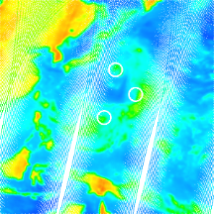
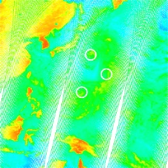
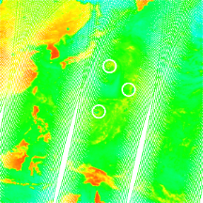
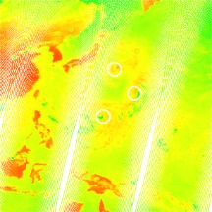
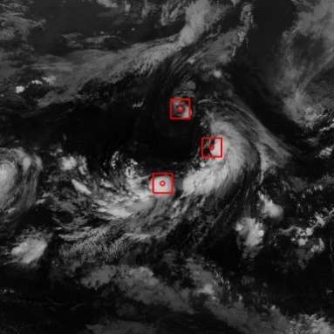

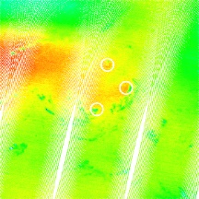

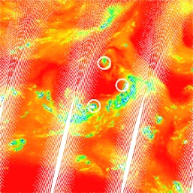
Chapter 2
Dataset
Describe the data modalities, used channels, labels or targets, data split, preprocessing, and known limitations.
Fig. 1: Example infrared input
Fig. 2: Example microwave input
Notes:
尾部电流源，形成差分结构，抑制共模噪声；但引入新噪声，用电容消除；理论上增大调频范围，引入相噪

Slide 5
Chapter 3
Project Tasks and Evaluation Metrics
Explain the task defined by your group and state measurable objectives. Select task-appropriate metrics and justify any threshold or decision rule.
Notes:
尾部电流源，形成差分结构，抑制共模噪声；但引入新噪声，用电容消除；理论上增大调频范围，引入相噪

Slide 6
Chapter 4
Proposed Methods
Briefly describe the selected statistical, signal-processing, machine-learning, or deep-learning method, including the key design choices.
Notes:
尾部电流源，形成差分结构，抑制共模噪声；但引入新噪声，用电容消除；理论上增大调频范围，引入相噪

Slide 7
Chapter 5
Results Analysis
Present quantitative and qualitative results, comparisons or ablations, and the main findings related to the stated objectives.
Notes:
尾部电流源，形成差分结构，抑制共模噪声；但引入新噪声，用电容消除；理论上增大调频范围，引入相噪

Slide 8
Chapter 6
Conclusion
Summarize the selected problem, method, strongest findings, whether the objectives were met, discuss limitations and specific future work.
Notes:
尾部电流源，形成差分结构，抑制共模噪声；但引入新噪声，用电容消除；理论上增大调频范围，引入相噪

